Slide 1

You know I’m all about that Bayes a (relatively) gentle introduction to Bayesian statistics
SDOS Brownbag
University of Maryland, College Park, MD
October 14, 2019
James A. Grand

Slide 2
For slides, code, and data:
https://github.com/grandjam/bayesianTutorial
Supplementary Materials

Slide 3


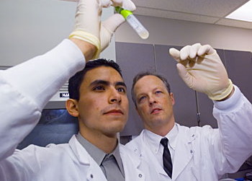
Frequentist/NHST → statistical inference as skepticism
Start with evidence → try to demonstrate it is implausible (Popperian)
p-values/confidence intervals → probability that sampled observation would be this different from comparison value if same experiment repeated infinitely
Limitations
Evidence that something is implausible ≠ evidence of what is plausible
No indication of plausibility for specific conclusions
Meehl’s Paradox (1967) – NHST is a weak bar for supporting theoretical inference
“I believe the sky is red.”
H₀: The sky is NOT red.
HA! See told you, the sky isn’t NOT red!
Umm...ok, but you think
the sky is actually red?
Frequentist vs. Bayesian Inference

Slide 4
Bayesian → statistical inference as active interpretation
Start with beliefs about the world → update beliefs based on evidence
“I believe the sky is red.”
H: There’s a 5% chance that the sky is red
I’ve noticed that the sky is red for roughly 1 hour of the day (sunrise/sunset);
1/24 = 4.2% of day
Ok...it could be that the sky is really red and is covered up 23hrs/day...
but seems unlikely
Frequentist vs. Bayesian Inference

Slide 5
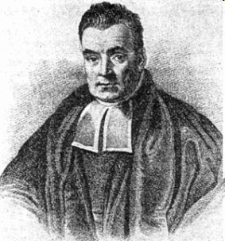

Probabilistic model for the question: “How can we infer the likelihood of a future event based on what we know about past occurrences of that event?”
Thomas Bayes
You polled 30 people outside the theater for their ratings. Based on your observations, what are the chances you think the next person you ask will rate it 5 stars?
Suppose you find out that 90% of movie-goers in a national poll gave the movie a 5-star rating. Would you change your guess?
Bayes’ Theorem

Slide 6

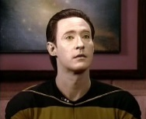

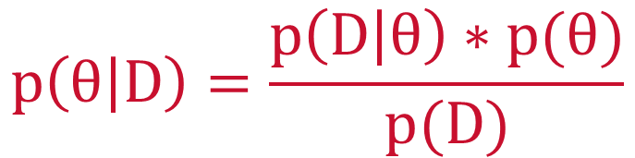
$$p\left(θ | D\right)=\frac{p\left(D | θ\right)∗p(θ)}{p(D)}$$
D = data/observations
θ = parameter/hypothesis
Logic of Bayesian inference:
We have beliefs → prior probability/degree of belief in parameter [p(θ)]
We observe stuff → likelihood of data given possible parameter values [p(D|θ)]
We (re)evaluate beliefs in light of data→ posterior probability/degree of belief in parameter based on observed data [p(θ|D)]
Prior
Likelihood of data
Posterior
Bayes’ Theorem
Notes:
p(D) = marginal likelihood of data. This is effectively a normalizing constant that ensures the posterior distribution can be interpreted as a probability distribution whose density sums to 1

Slide 7
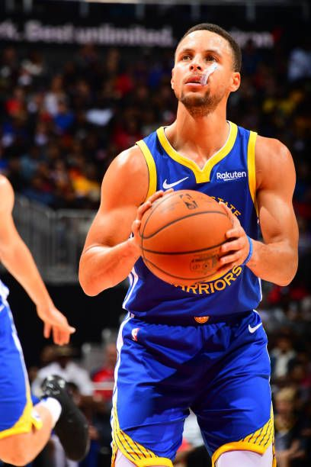
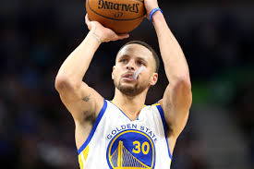
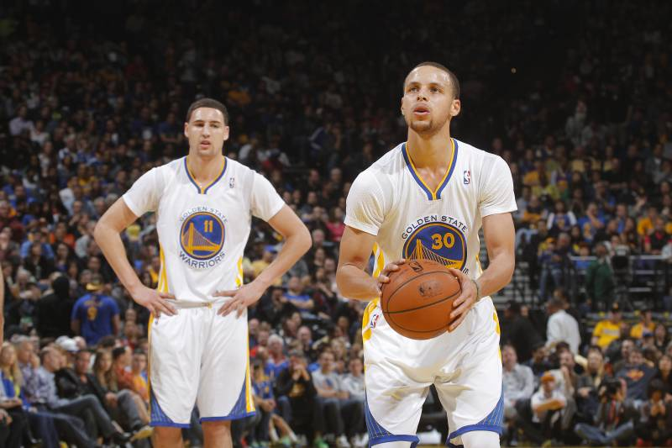
Steph Curry is the NBA’s current all-time leader in free throw percentage; across 10 seasons, he’s made 90.47% of all his free throw shots. When asked about the secret to his success, Curry says “It’s my mouth-guard—when I have it in, I can’t miss.” An interested statistician (with too much time on his hands) took this statement to heart and found video of every free throw Curry has taken in his career. He notes that Curry has worn a mouth-guard in 79% of all his games; additionally, Curry made 94.2% of his free throws when wearing the mouth-guard.
Let’s assume I just saw Steph make a free throw, but I’m sitting so far away from the court that I can’t see whether he’s wearing his mouth-guard…
What’s the probability he’s protecting those chompers?
Bayes in Action

Slide 8
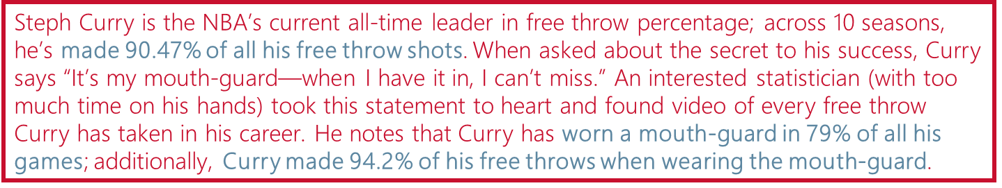
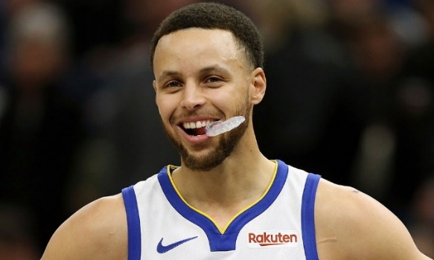
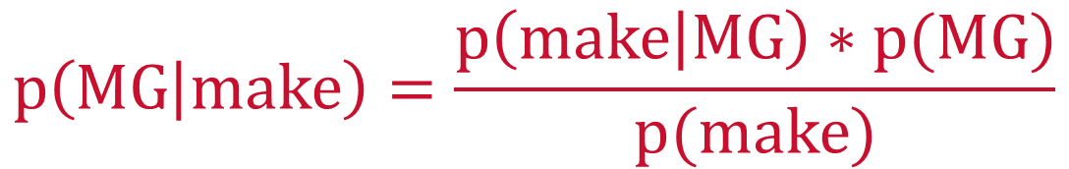
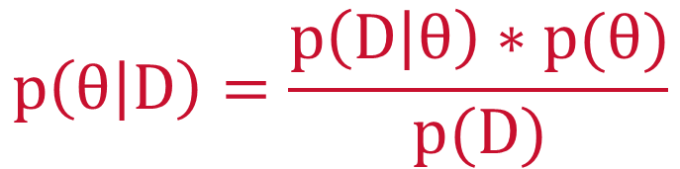
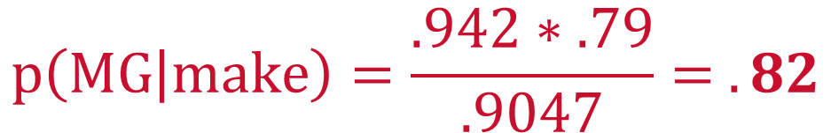
$$p\left(θ | D\right)=\frac{p\left(D | θ\right)∗p(θ)}{p(D)}$$
What I want to guess/estimate
Informative data
$$p\left(MG | make\right)=\frac{p\left(make | MG\right)∗p(MG)}{p(make)}$$
Probability Statements | Values
P(make) = | .9047
P(MG) = | .790
P(make|MG) = | .942
$$p\left(MG | make\right)=\frac{.942∗.79}{.9047}= .82$$
Bayes in Action

Slide 9

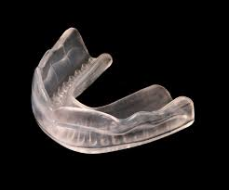

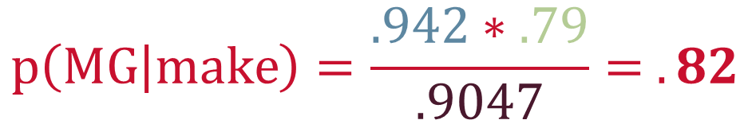
$$p\left(MG | make\right)=\frac{.942∗.79}{.9047}= .82$$
MG|make
Make with MG
Posterior is our best guess informed by previous and current observations
Posterior
Likelihood
79%
90%
82%
94%
75%
80%
85%
90%
95%
100%
MG
Make
Prior
Marginal likelihood
Bayes in Action

Slide 10
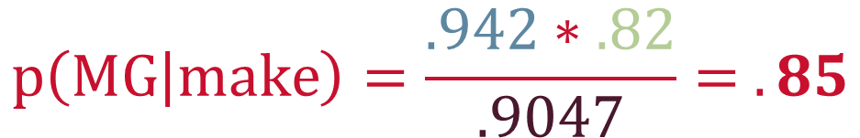
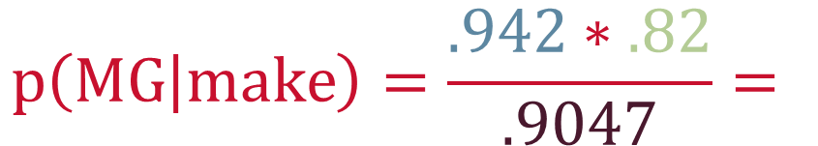
$$p\left(MG | make\right)=\frac{.942∗.79}{.9047}= .82$$
$$p\left(MG | make\right)=\frac{.942∗.82}{.9047}=$$
$$p\left(MG | make\right)=\frac{.942∗.82}{.9047}= .85$$
Bayesian updating: Posterior can become prior for making subsequent guesses
MG|make
MG|make
Make with MG
New
posterior
Old
Posterior
Likelihood
Steph makes another FT—does my prediction change?
79%
82%
90%
85%
82%
94%
75%
80%
85%
90%
95%
100%
MG
MG
Make
Old
prior
New
prior
Marginal likelihood
Bayesian inference thus provides a natural means for accumulating evidence
Bayes in Action

Slide 11
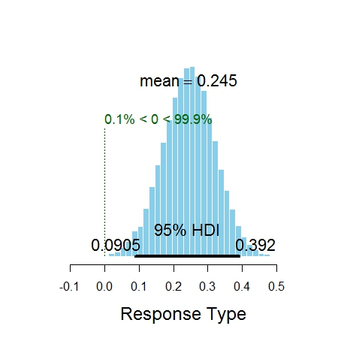
$$p\left(θ | D\right)=\frac{p\left(D | θ\right)∗p(θ)}{p(D)}$$
In research, often most interested in estimating parameters (θ) that help us evaluate hypotheses
In Bayesian statistics, we estimate distributions that summarize plausibility of posterior estimates
Bayesian Statistics

Slide 12
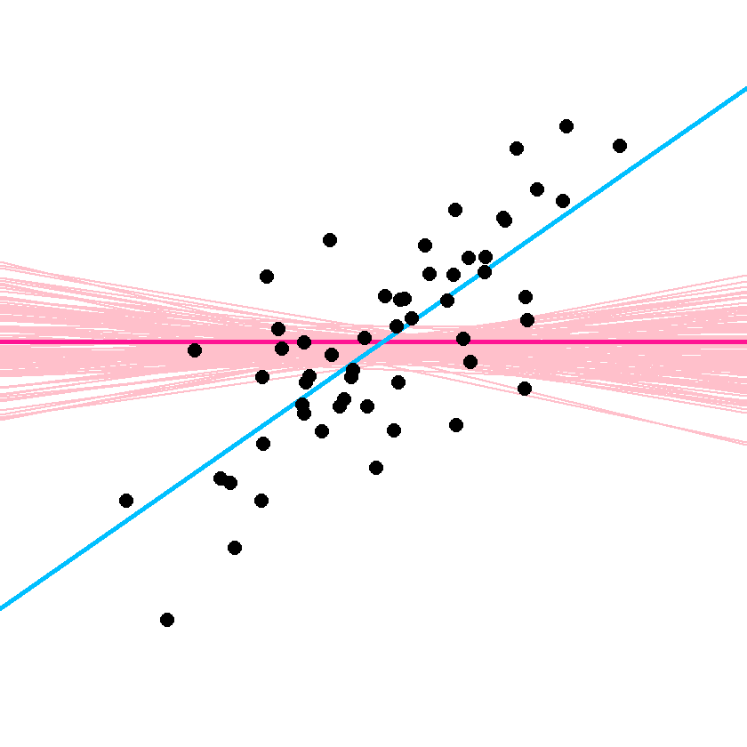
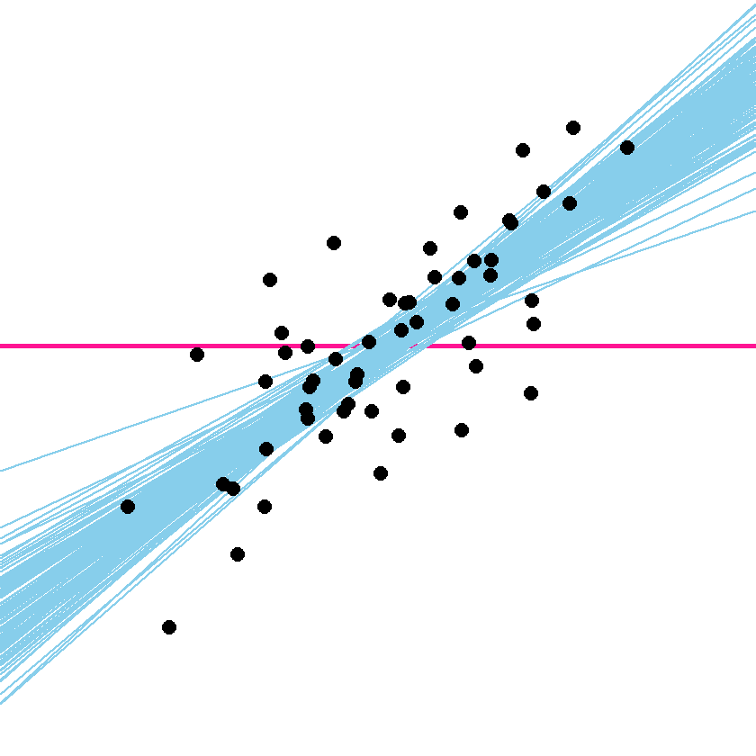
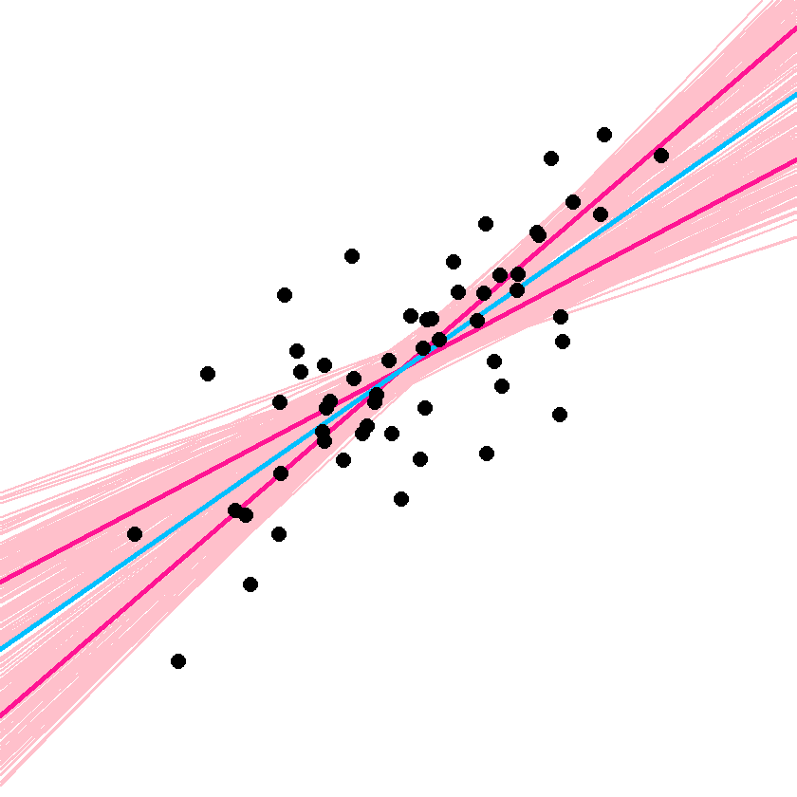
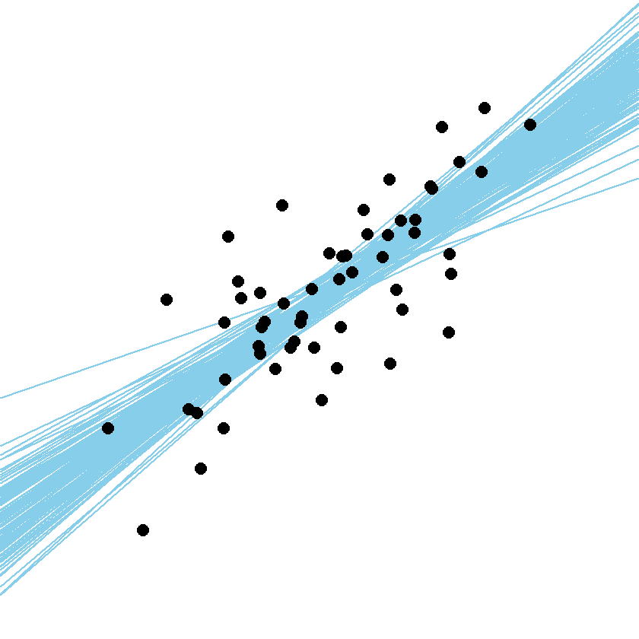
Here is where understanding difference between frequentist and Bayesian inference becomes important…
Takeaways for Bayes
No reliance on sampling distributions
Direct interpretation of estimates
Frequentist
Bayesian
Sampling distribution for H₀ (values ~= 0)
Posterior distribution of credible values
(Null) Hypothesis Assessment
Does data fit hypothesis?
Does hypothesis fit data?
Confidence interval limits & their sampling distribution
Posterior distribution of credible values
Parameter Estimation
What θ’s don’t
differ from observed θ?
What are most likely θ’s?
Bayesian Statistics
All images copyright John K. Krushke. Distributed under Creative Commons 4.0 License. Source: http://doingbayesiandataanalysis.blogspot.com/2014/02/improved-icons-for-bayesian-and.html

Slide 13
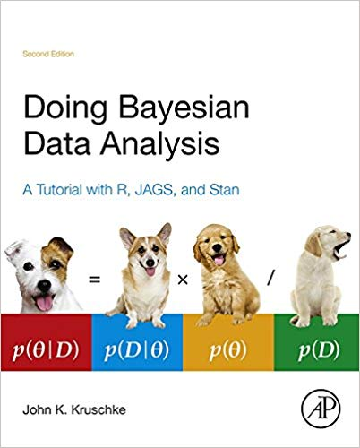
Strap in…let’s get ready to go Bayes!
Goal today is to get you started down the path
For those wanting more, HIGHLY recommend John Kruschke’s textbook
I receive no royalties or finders’ fees if you buy this book – it’s just a great way to learn Bayesian statistics
Bayesian Statistics

Slide 14
Two foundational concepts in Bayesian statistics
1
Bayesian inference is reallocation of credibility across possibilities
Imagine probability like a water pitcher with one glass of water in it
Bayesian Statistics
This explanation from: Rohrer, B. (2016). How Bayes theorem works [video file]. Retrieved from https://www.youtube.com/watch?v=5NMxiOGL39M
Kruschke, J.K (2015). Doing Bayesian data analysis: A tutorial with R, JAGS, and Stan (2nd ed). Academic Press: Boston, MA

Slide 15
Two foundational concepts in Bayesian statistics
1
Bayesian inference is reallocation of credibility across possibilities
If you have only one cup, you can fill it completely
100%
Bayesian Statistics
This explanation from: Rohrer, B. (2016). How Bayes theorem works [video file]. Retrieved from https://www.youtube.com/watch?v=5NMxiOGL39M
Kruschke, J.K (2015). Doing Bayesian data analysis: A tutorial with R, JAGS, and Stan (2nd ed). Academic Press: Boston, MA

Slide 16
Two foundational concepts in Bayesian statistics
1
Bayesian inference is reallocation of credibility across possibilities
If you have two cups, you have to decide how to share (distribute) it
65%
35%
Bayesian Statistics
This explanation from: Rohrer, B. (2016). How Bayes theorem works [video file]. Retrieved from https://www.youtube.com/watch?v=5NMxiOGL39M
Kruschke, J.K (2015). Doing Bayesian data analysis: A tutorial with R, JAGS, and Stan (2nd ed). Academic Press: Boston, MA

Slide 17
Two foundational concepts in Bayesian statistics
1
Bayesian inference is reallocation of credibility across possibilities
In this metaphor, cups represent possibilities
65%
35%
Bayesian Statistics
This explanation from: Rohrer, B. (2016). How Bayes theorem works [video file]. Retrieved from https://www.youtube.com/watch?v=5NMxiOGL39M
Kruschke, J.K (2015). Doing Bayesian data analysis: A tutorial with R, JAGS, and Stan (2nd ed). Academic Press: Boston, MA

Slide 18

Two foundational concepts in Bayesian statistics
1
Bayesian inference is reallocation of credibility across possibilities
In this metaphor, cups represent possibilities
79%
21%
No MG
MG
Bayesian Statistics
This explanation from: Rohrer, B. (2016). How Bayes theorem works [video file]. Retrieved from https://www.youtube.com/watch?v=5NMxiOGL39M
Kruschke, J.K (2015). Doing Bayesian data analysis: A tutorial with R, JAGS, and Stan (2nd ed). Academic Press: Boston, MA

Slide 19
Two foundational concepts in Bayesian statistics
1
Bayesian inference is reallocation of credibility across possibilities
Considering more possibilities requires us to redistribute further
79%
21%
74%
16%
5%
5%
No MG,
Make
No MG,
Miss
MG,
Make
MG,
Miss
Bayesian Statistics
This explanation from: Rohrer, B. (2016). How Bayes theorem works [video file]. Retrieved from https://www.youtube.com/watch?v=5NMxiOGL39M
Kruschke, J.K (2015). Doing Bayesian data analysis: A tutorial with R, JAGS, and Stan (2nd ed). Academic Press: Boston, MA

Slide 20
Two foundational concepts in Bayesian statistics
1
Bayesian inference is reallocation of credibility across possibilities
The amount of water in a glass in this metaphor represents the strength of our belief in each possibility
74%
16%
5%
5%
No MG,
Make
No MG,
Miss
MG,
Make
MG,
Miss
Bayesian Statistics
This explanation from: Rohrer, B. (2016). How Bayes theorem works [video file]. Retrieved from https://www.youtube.com/watch?v=5NMxiOGL39M
Kruschke, J.K (2015). Doing Bayesian data analysis: A tutorial with R, JAGS, and Stan (2nd ed). Academic Press: Boston, MA

Slide 21
Two foundational concepts in Bayesian statistics
1
Bayesian inference is reallocation of credibility across possibilities
When we witness an observation, Bayesian inference reallocates the probability of possibilities accordingly
.74
Prior
Probability
.16
.05
.05
No MG,
Make
No MG,
Miss
MG,
Make
MG,
Miss
.82
Posterior
Probability
.18
.00
.00
No MG,
Make
No MG,
Miss
MG,
Make
MG,
Miss
Bayesian Statistics
This explanation from: Rohrer, B. (2016). How Bayes theorem works [video file]. Retrieved from https://www.youtube.com/watch?v=5NMxiOGL39M
Kruschke, J.K (2015). Doing Bayesian data analysis: A tutorial with R, JAGS, and Stan (2nd ed). Academic Press: Boston, MA
Notes:
In this example, we reallocated the 10% probability assigned to missing the shot to making the shot. The reason that MG, Make goes up more than No MG, Make is because the prior probability of MG (79%) is much higher than prior probability of ~MG (21%). Thus, our prior knowledge influences our posterior

Slide 22
Two foundational concepts in Bayesian statistics
2
Possibilities are parameter values in descriptive (statistical) models
In statistics, the possibilities that we entertain are often not discrete but continuous → thus we deal with probability distributions
Adult height (cm)
.28
.24
Probability
.17
.12
.09
.06
.03
.01
<150
150- 160
160-
170
170-
180
180-
190
190-
200
200-
210
>210
Bayesian Statistics
This explanation from: Rohrer, B. (2016). How Bayes theorem works [video file]. Retrieved from https://www.youtube.com/watch?v=5NMxiOGL39M
Kruschke, J.K (2015). Doing Bayesian data analysis: A tutorial with R, JAGS, and Stan (2nd ed). Academic Press: Boston, MA

Slide 23
Two foundational concepts in Bayesian statistics
2
Possibilities are parameter values in descriptive (statistical) models
In statistics, the possibilities that we entertain are often not discrete but continuous → thus we deal with probability distributions
Adult height (cm)
.16
.13
.12
.10
.11
Probability
.06
.07
.07
.04
.05
.05
.02
.01
.01
<150
150- 155
155-
160
160-
165
165-
170
170-
175
175-
180
180-
185
185-
190
190-
195
195-
200
200-
205
205-
210
>210
Bayesian Statistics
This explanation from: Rohrer, B. (2016). How Bayes theorem works [video file]. Retrieved from https://www.youtube.com/watch?v=5NMxiOGL39M
Kruschke, J.K (2015). Doing Bayesian data analysis: A tutorial with R, JAGS, and Stan (2nd ed). Academic Press: Boston, MA

Slide 24
Two foundational concepts in Bayesian statistics
2
Possibilities are parameter values in descriptive (statistical) models
In statistics, the possibilities that we entertain are often not discrete but continuous → thus we deal with probability distributions
Adult height (cm)
Probability
150
160
170
180
190
200
210
Bayesian Statistics
This explanation from: Rohrer, B. (2016). How Bayes theorem works [video file]. Retrieved from https://www.youtube.com/watch?v=5NMxiOGL39M
Kruschke, J.K (2015). Doing Bayesian data analysis: A tutorial with R, JAGS, and Stan (2nd ed). Academic Press: Boston, MA

Slide 25
Two foundational concepts in Bayesian statistics
2
Possibilities are parameter values in descriptive (statistical) models
In statistics, the possibilities that we entertain are often not discrete but continuous → thus we deal with probability distributions
Adult height (cm)
Probability
`
150
160
170
180
190
200
210
Bayesian Statistics
This explanation from: Rohrer, B. (2016). How Bayes theorem works [video file]. Retrieved from https://www.youtube.com/watch?v=5NMxiOGL39M
Kruschke, J.K (2015). Doing Bayesian data analysis: A tutorial with R, JAGS, and Stan (2nd ed). Academic Press: Boston, MA

Slide 26
Two foundational concepts in Bayesian statistics
2
Possibilities are parameter values in descriptive (statistical) models
In statistics, the possibilities that we entertain are often not discrete but continuous → thus we deal with probability distributions
Adult height (cm)
Probability
150
160
170
180
190
200
210
Bayesian Statistics
This explanation from: Rohrer, B. (2016). How Bayes theorem works [video file]. Retrieved from https://www.youtube.com/watch?v=5NMxiOGL39M
Kruschke, J.K (2015). Doing Bayesian data analysis: A tutorial with R, JAGS, and Stan (2nd ed). Academic Press: Boston, MA

Slide 27
Two foundational concepts in Bayesian statistics
2
Possibilities are parameter values in descriptive (statistical) models
Distributions are defined by parameters that describe their shape
Adult height (cm)
Mean (μ)
Probability
SD (σ)
150
160
170
180
190
200
210
Bayesian Statistics
Kruschke, J.K (2015). Doing Bayesian data analysis: A tutorial with R, JAGS, and Stan (2nd ed). Academic Press: Boston, MA

Slide 28
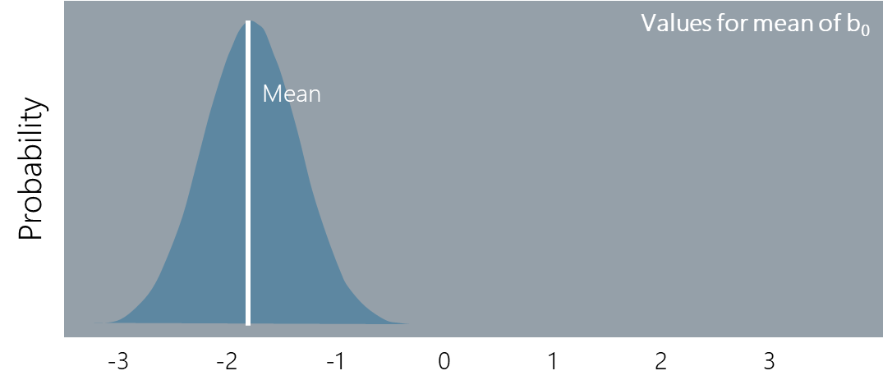
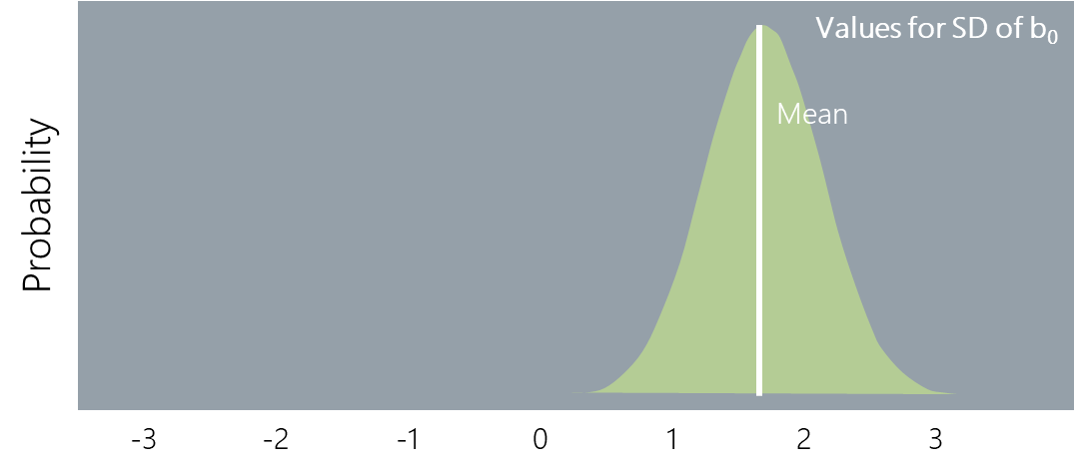
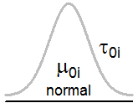
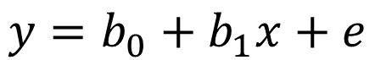
Two foundational concepts in Bayesian statistics
2
Possibilities are parameter values in descriptive (statistical) models
In Bayesian statistics, we attempt to estimate distributions of credible values for parameters of the statistical model
~
$$y=b_{0}+b_{1}x+e$$
Bayesian Statistics
Kruschke, J.K (2015). Doing Bayesian data analysis: A tutorial with R, JAGS, and Stan (2nd ed). Academic Press: Boston, MA

Slide 29

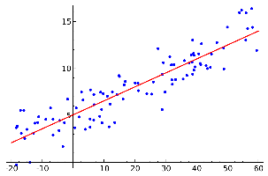


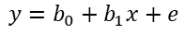
Five steps in all Bayesian analyses:
Collect data relevant to the research question
1
$$y=b_{0}+b_{1}x+e$$
Define a descriptive (statistical) model for the data
2
Specify prior distributions for the model parameters
3
Use Bayesian inference to generate posterior distribution for credible parameter values
4
Check that posterior predictions mimic data with reasonable accuracy
If poor fit, consider different model
5
Bayesian Statistics
Kruschke, J.K (2015). Doing Bayesian data analysis: A tutorial with R, JAGS, and Stan (2nd ed). Academic Press: Boston, MA

Slide 30
Let’s work a simple example to make this concrete
Return to the heady days of early grad school and my first attempt at doing research…
Does self-efficacy for mechanical tasks predict performance on tests of mechanical comprehension?
Mechanical Interest, Knowledge and Experiences
Mechanical Self-Efficacy
Performance on Test of Mechanical Comprehension
Gender Role Identification
Gender Stereotype Endorsement
Bayesian Regression Example

Slide 31
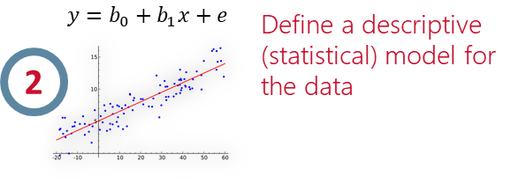
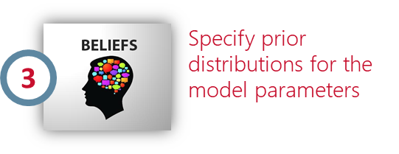
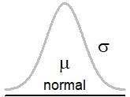
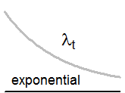
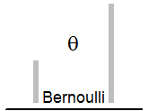
To set up a model for Bayesian inference, we have to define a likelihood distribution and prior distributions for parameters
Likelihood distribution
How values for the DV are distributed
How to choose?
Categorical vs. continuous variable?
Examine data
Refer to previous theory or data
Bayesian Regression Example

Slide 32
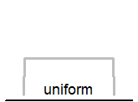
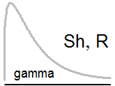
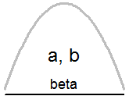
To set up a model for Bayesian inference, we have to define a likelihood distribution and prior distributions for parameters
Prior distribution
How values for the model parameters are distributed
How to choose?
What do you believe are plausible values?
Use existing theory/literature to inform
Consider nature of parameter (can negative values exist? Restricted from 0-1?)
Critical aspect of Bayesian analyses is transparency in selecting & justifying prior!
Bayesian Regression Example

Slide 33
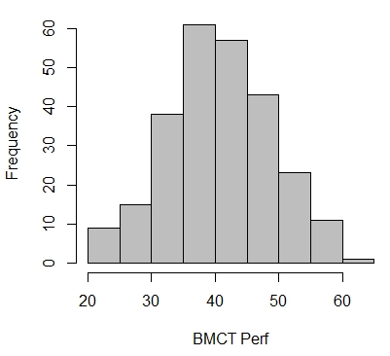
Often helpful to “build” Bayesian model in chunks and visualize with a graphic
Likelihood distribution
Will end up estimating parameters of the likelihood distribution
Likelihood distribution describes the data → thus try to predict the parameters that control this distribution
Test Perf ~ normal(mean = μ, SD = σ)
~
Test Perf
Bayesian Regression Example

Slide 34
Often helpful to “build” Bayesian model in chunks and visualize with a graphic
Descriptive statistical model
Test Perf = b₀ + b₁(mechSE) + σ
Rather than predict Test Perf, we predict the mean (μ) of its distribution
i.e., relationship between predictors and “best guess” of test perf
Test Perf μ_{TestPerf} = b₀ + b₁(mechSE) + σ
b₀ + b₁(mechSE)
=
~
Test Perf
Bayesian Regression Example

Slide 35
Often helpful to “build” Bayesian model in chunks and visualize with a graphic
Prior distributions
We have three parameters that need priors in this model
b₀ → What is intercept for Test Perf?
b₁ → What is relationship between SE and Test Perf?
σ → What is variance in Test Perf? (residuals)
Uniform priors
“All estimates equally likely”
Noncommital/vague prior – prior will not strongly influence posterior
Results will be essentially identical to frequentist
~
~
b₀ + b₁(mechSE)
=
~
~
Test Perf
Bayesian Regression Example

Slide 36
Often helpful to “build” Bayesian model in chunks and visualize with a graphic
Prior distributions
We have three parameters that need priors in this model
b₀ → What is intercept for Test Perf?
b₁ → What is relationship between SE and Test Perf?
σ → What is variance in Test Perf? (residuals)
Normal priors
“Values near mean more likely”
If narrow, can be highly influential
~
~
b₀ + b₁(mechSE)
=
~
~
Test Perf
Bayesian Regression Example

Slide 37
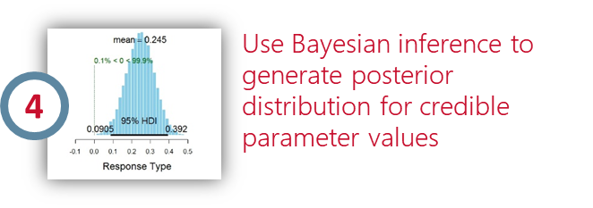
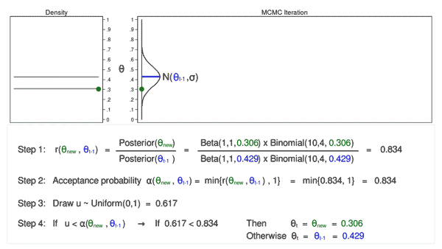
The Bayesian magic...
Posterior distributions must be “constructed”
Accomplished by using a sampling algorithm to generate candidate values and applying Bayes Theorem to evaluate their plausibility
Result is a trace plot → should look like a fuzzy caterpillar
With enough samples, trace plot histogram will approximate posterior distribution
Example of Metropolis-Hastings algorithm for generating posterior samples
GREAT NEWS! You don’t have to understand how this sampling works to run or interpret Bayesian analyses!
Bayesian Regression Example
https://blog.stata.com/2016/11/15/introduction-to-bayesian-statistics-part-2-mcmc-and-the-metropolis-hastings-algorithm/

Slide 38




Some options for Bayesian analyses:
JASP
Point & click GUI
Frequentist & Bayesian analyses
JAGS
STAN
Computes BFs and MCMC samples
Packages
bayesfactor
Markov Chain Monte Carlo (MCMC) sampler
Packages
rjags
runjags
Hamiltonian Monte Carlo (HMC) sampler
Packages
rstan
rstanarm
brms
Difficulty of Use & Flexibility
Bayesian Regression Example

Slide 39
Advantages of Bayesian approaches
It’s what the cool kids are doing!
Lets you evaluate what you actually want to know (i.e., direct evaluation of parameters)
Interpretation does not depend on (weird) assumptions of sampling distributions
Bayesian updating → natural accumulation of results
Prior
Likelihood of data
Posterior
Conclusion

Slide 40
Thank You!
James A. Grand
e-mail: grandjam@umd.edu
https://github.com/grandjam/bayesianTutorial

